Slide 1

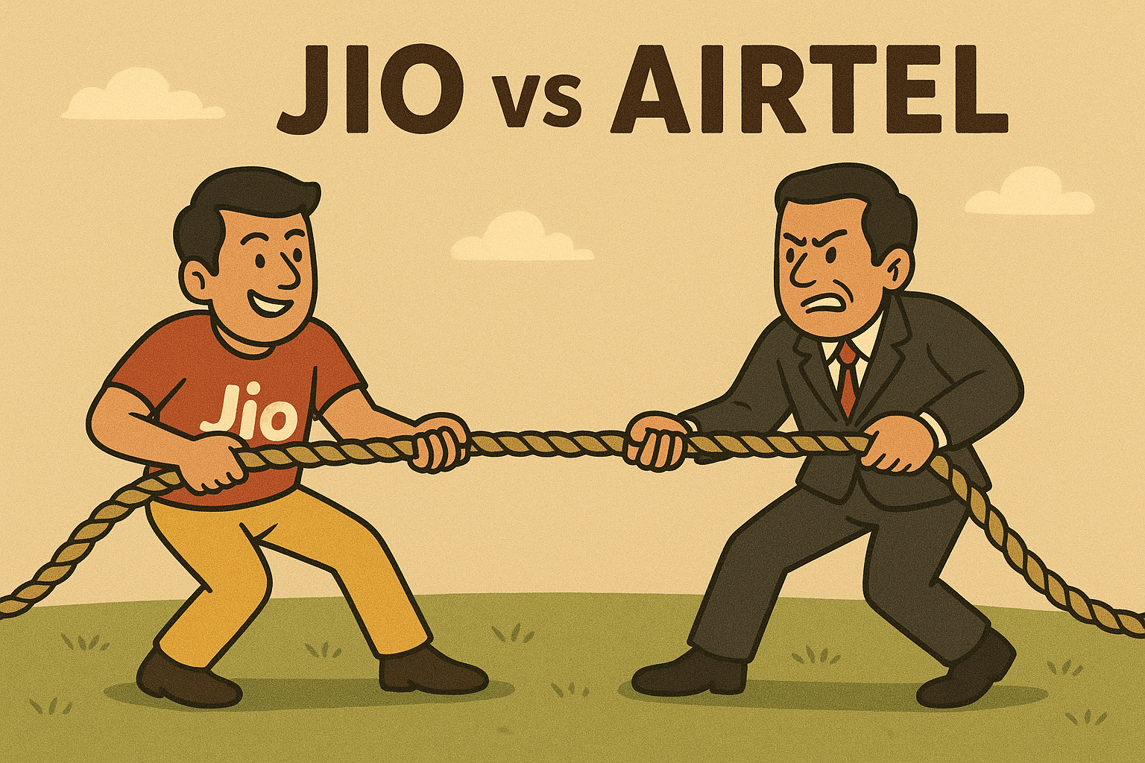
STORYTELLING
Duopoly and Dominance of Jio &Airtel

Slide 2
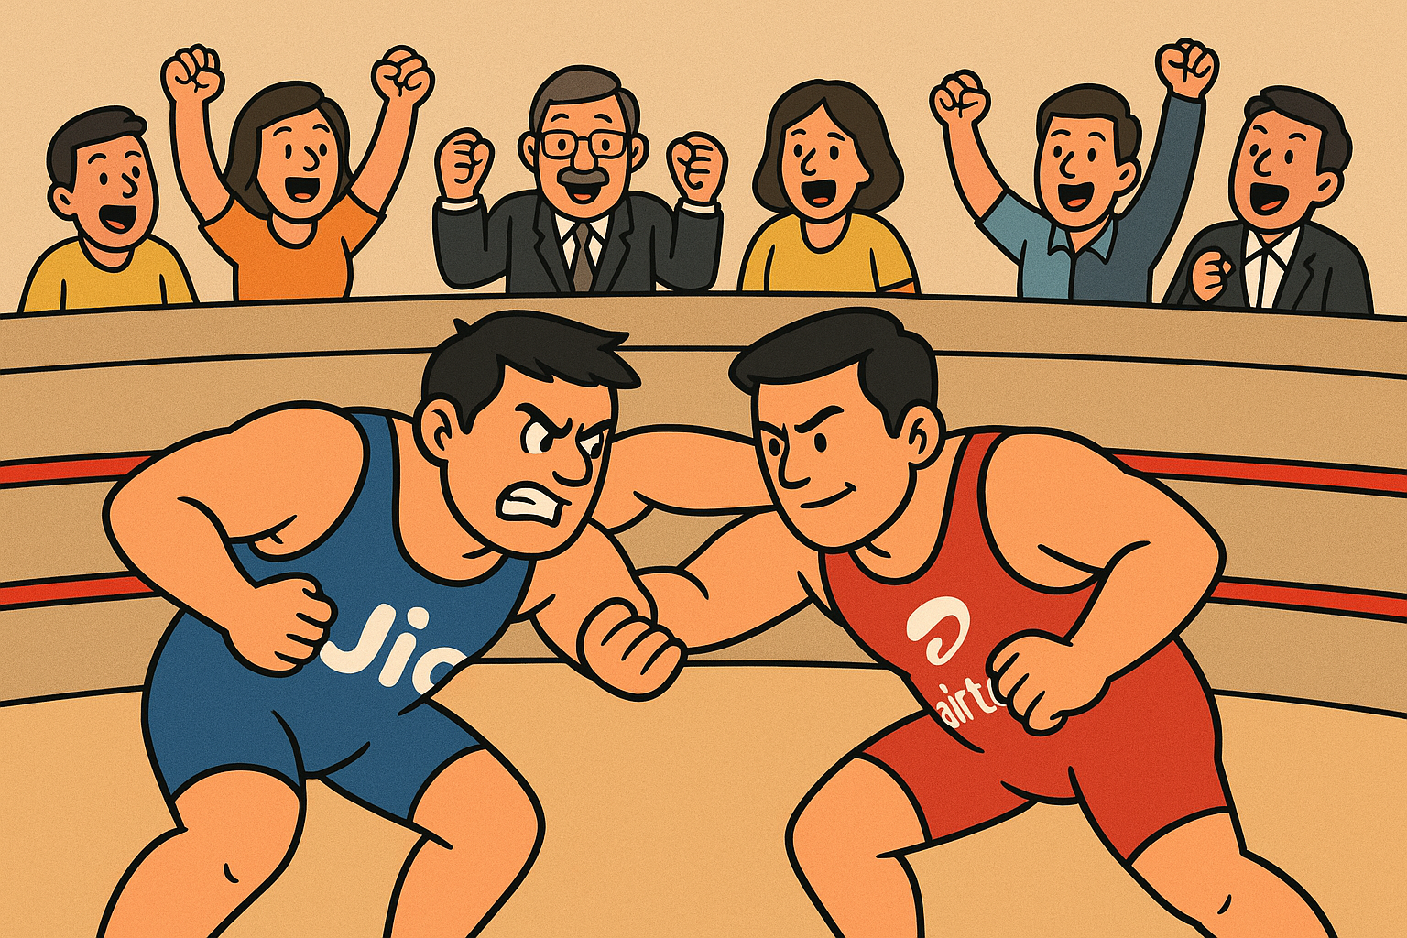
1. Tug-of-war
“Indian Telecom: One rope. Two giants. Everyone else… invisible.”
This is the story of Indian telecom today — one rope, two giants, and everyone else is just watching.

Slide 3
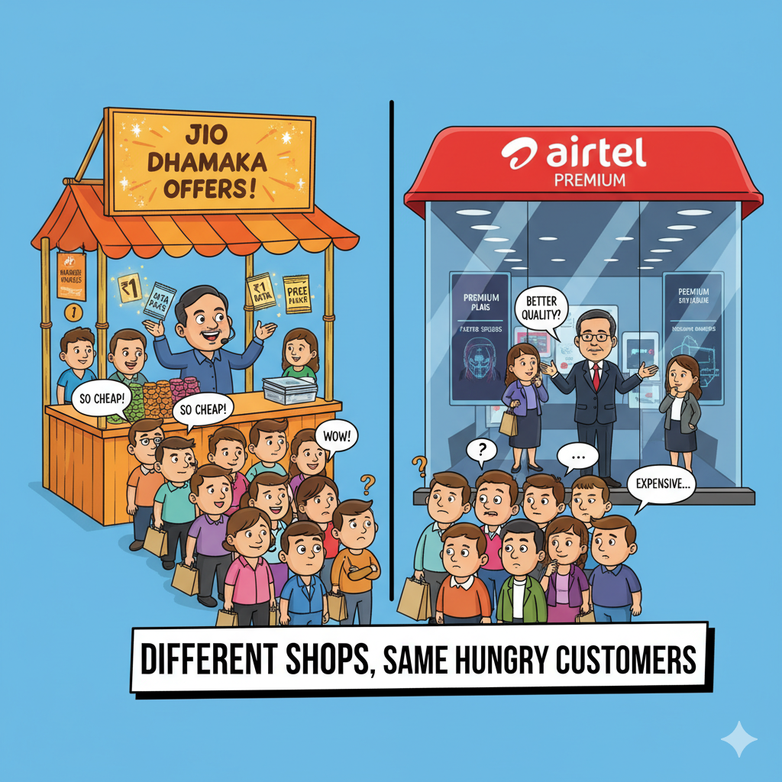
2. Customer Churn
“Every customer is a tug-of-war prize.”
Every customer is like this — confused which SIM to hold onto. For Jio and Airtel, churn is the real battleground

Slide 4
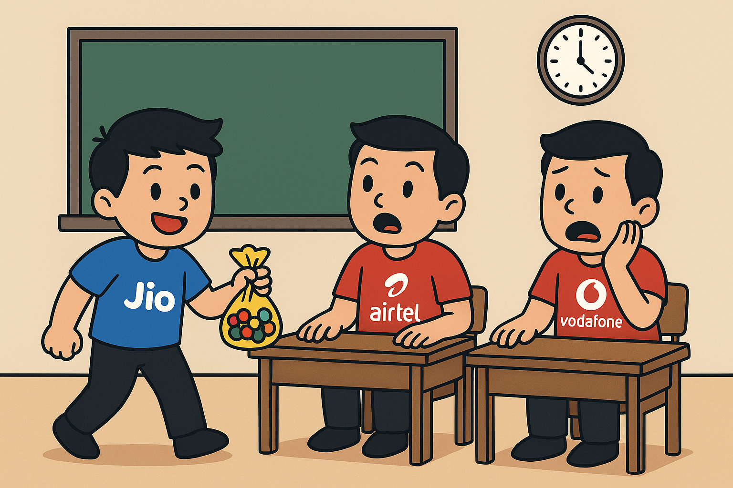
3. New Kid in Class
“Every customer is a tug-of-war prize.”
Remember that kid in school who bought everyone chocolates on the first day? That’s Jio in 2016.

Slide 5
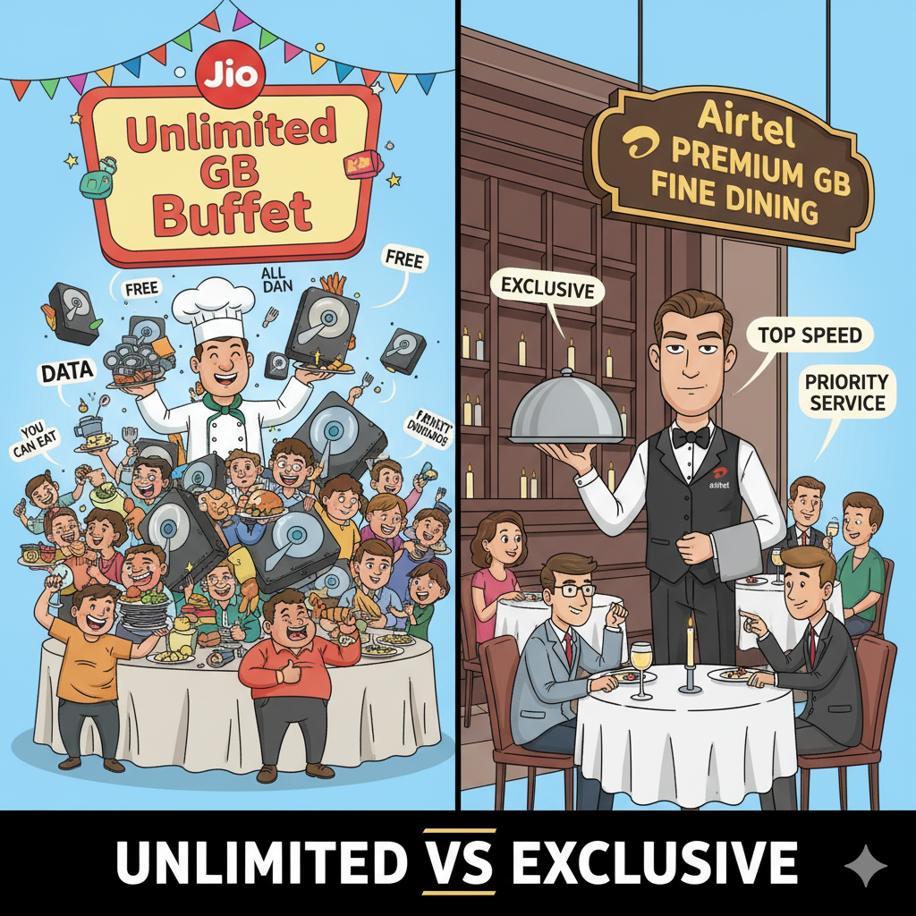
4. Price War
“Unlimited vs Premium: Guess who pulled the crowd?”
Jio set up a street-side stall shouting ‘Free! Unlimited!’ while Airtel was running a serious shop. Guess where the crowd went?

Slide 6
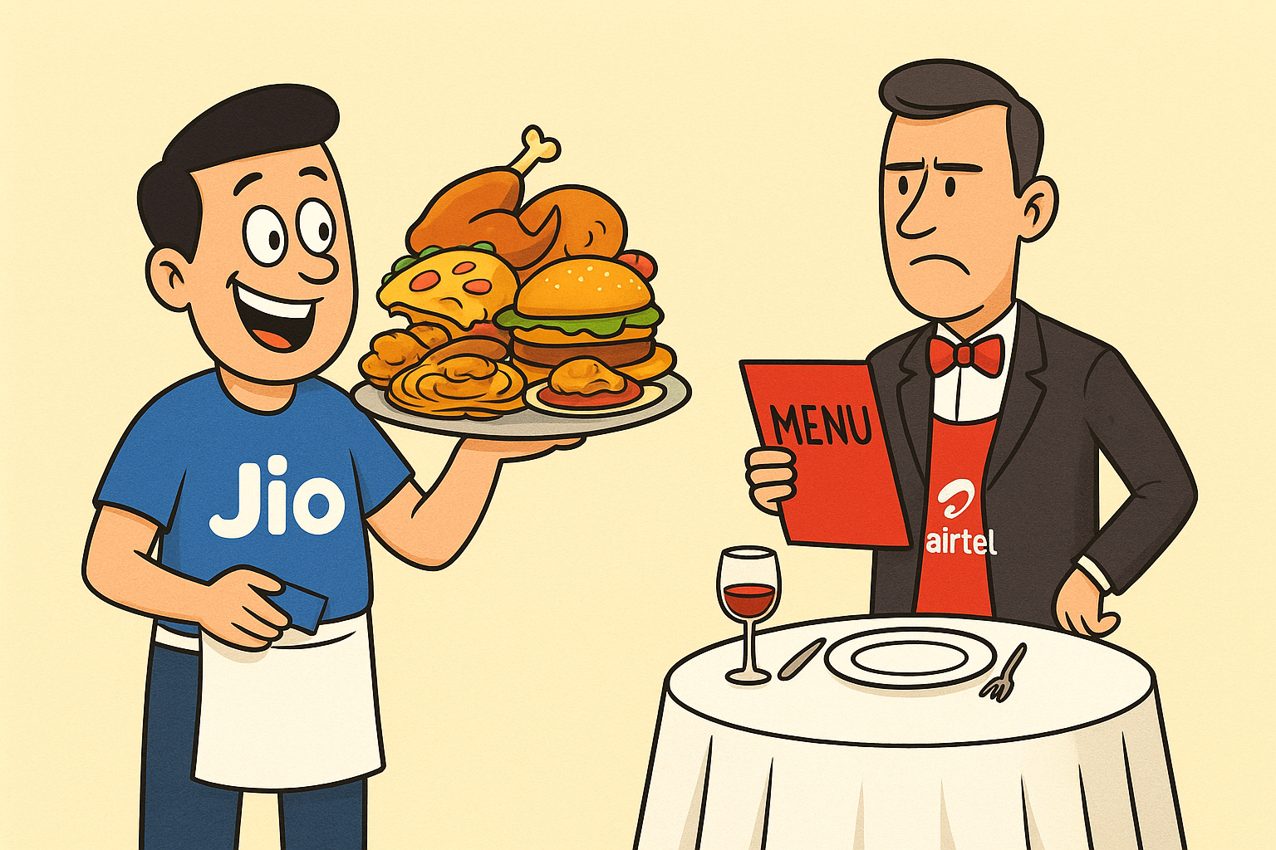
5. Buffet vs Fine Dining
“India prefers buffet over fine dining — especially for data.”
Jio turned data into an unlimited buffet. Airtel said, ‘We’re a fine dining restaurant.’ Indians, of course, went for the buffet first.

Slide 7
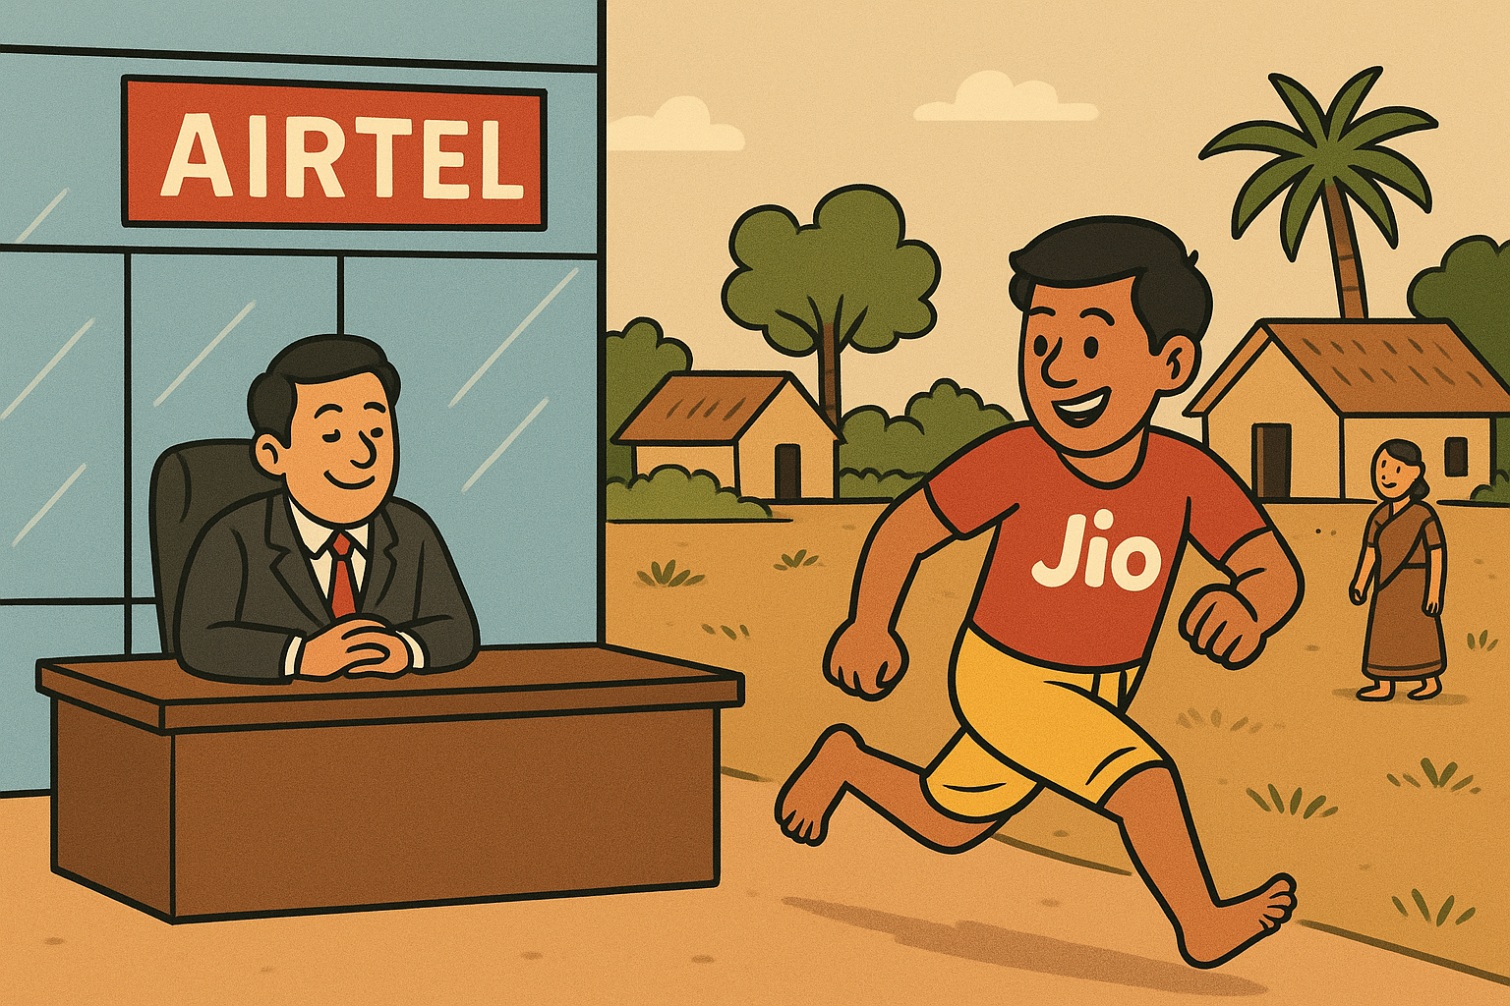
6. Airtel Corporate Office vs Jio Villages
“Jio runs in villages, Airtel sits in boardrooms.”
Airtel focused on glass towers and urban elite. Jio? It ran through villages, small towns, and got everyone online.

Slide 8
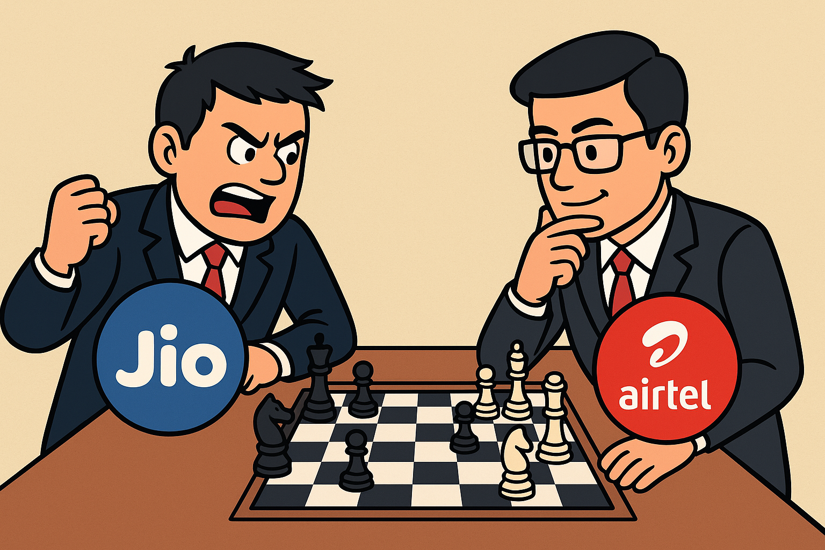
7. Chess Players
“Aggressive vs Strategic — the telecom chessboard.”
“Jio plays aggressively like a beginner who just attacks. Airtel plays like a seasoned strategist — patient, calculated.”

Slide 9
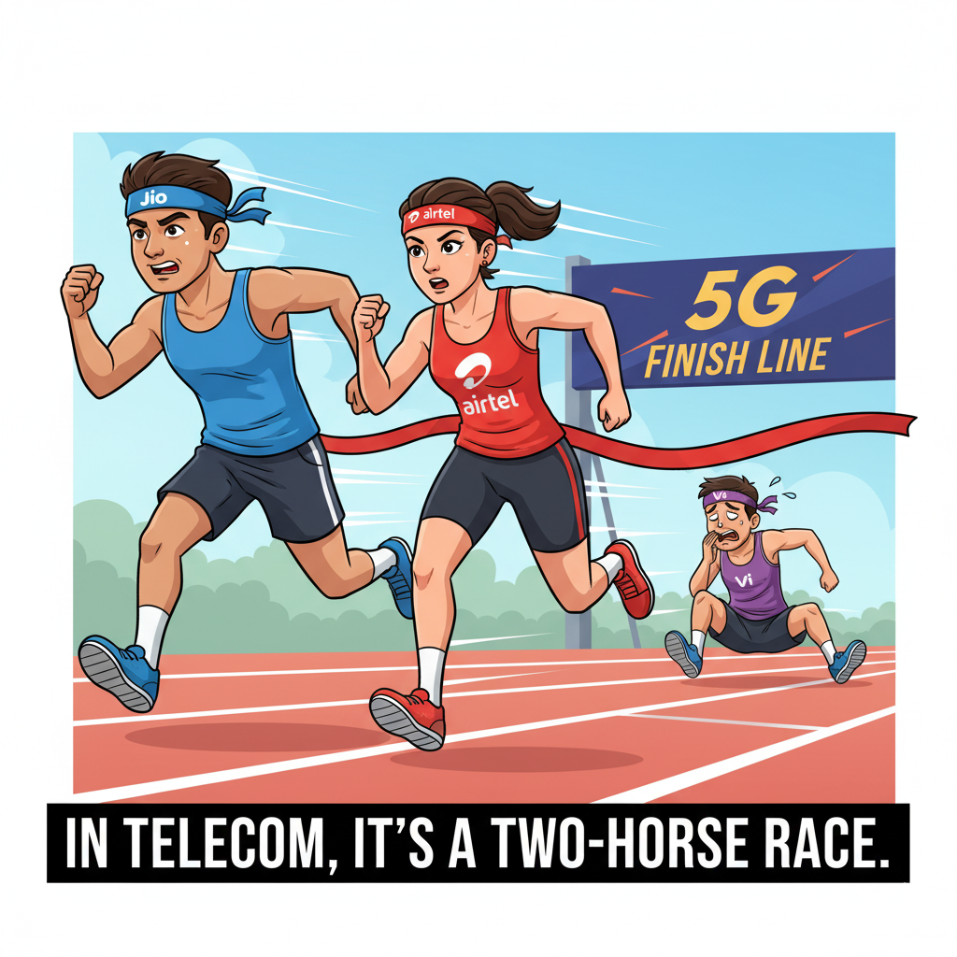
8. Two Racers (Jio vs Airtel)
“Jio = Turbo Sprint | Airtel = Strategic Marathon ”
Think of the telecom market like a race track. Jio sprinted like a new racer with a turbo engine — free data as fuel. Airtel, on the other hand, is the experienced racer — slower start but steady acceleration. The real question is: who wins in the long run?

Slide 10
9. Investors Cheering
“The crowd loves the fight… as long as the stock price rises.”
Meanwhile, investors are like cricket fans in the stadium — just enjoying the punches, as long as the stock price keeps rising.

Slide 11
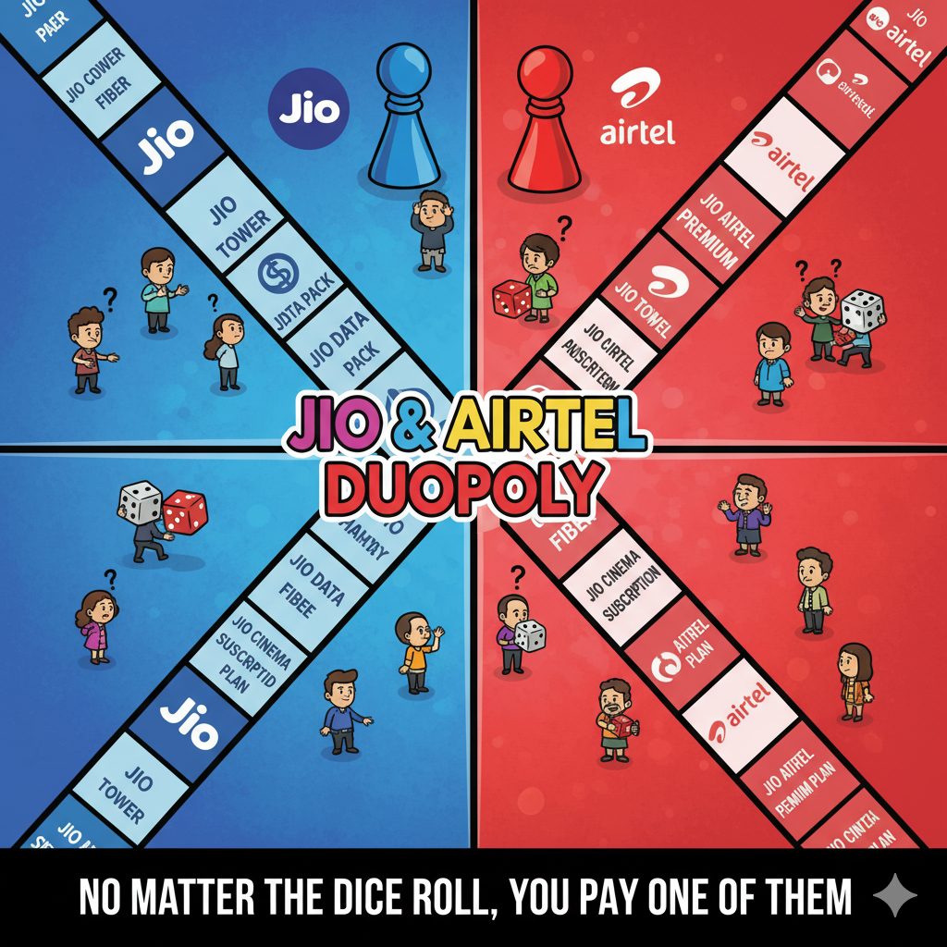
10. Duopoly Monopoly
“No matter the dice roll… you pay one of them.”
At the end of the day, no matter how you roll the dice… your money lands with either Jio or Airtel.

